Slide 1
Projectile Fragmentation of Heavy Ions
Zhiheng Hu
Learning Group · Zhiheng Hu · 11 Aug 2026
Notes:
【中文】
大家好。我是胡智恒，今天和大家分享的是重离子弹核碎裂——Projectile Fragmentation of Heavy Ions。
材料主要来自谷畑勇夫（Isao Tanihata）在《核物理实验技术》第10章里关于放射性束产生与利用的论述。我想带大家想清楚两件事：第一，为什么高能重离子的弹核碎裂，能把次级放射性束从“原则上可行”变成一条真正能做反应实验的生产线；第二，动量分布和分离原理，又是怎样决定最终束流品质的。
我们按问题往下走，有不清楚的随时打断。
[English]
Hi everyone — I'm Zhiheng Hu. Today I'll walk through projectile fragmentation of heavy ions.
This talk is based on Isao Tanihata's chapter on the production and use of radioactive beams, in Experimental Techniques in Nuclear Physics. There are really two things I want us to leave with. First: why high-energy heavy-ion fragmentation turned secondary radioactive beams from a principle into a practical production line for reaction studies. Second: how the fragment momentum distribution, and the way we separate species, set the quality of the beam you actually get on target.
I'll follow a few guiding questions.

Slide 2
Outline
1.Where does Projectile Fragmentation come from?
2. What is Projectile Fragmentation?
3. Why we need to use Projectile Fragmentation?
4.The practical use of Projectile Fragment.
Notes:
【中文】
先看一下今天的路线图，四个问题串起来：
第一，弹核碎裂从何而来——历史脉络，以及它作为一种反应机制本身的物理图像。
第二，弹核碎裂是什么——运动学特征、动量分布，以及 Goldhaber 宽度怎么刻画碎片云。
第三，我们为什么需要它——稳定线附近的经典限制，以及放射性次级束打开了什么。
第四，实际怎么用——生产靶、接受度、磁刚度与能量损失分离。
后面每一节都会对着这四个问题回答；最后我们再用同一框架做一次收束。
[English]
Here's the roadmap — four questions that structure the whole presentation.
One: where does projectile fragmentation come from — the historical path, and the physical picture of the reaction itself.
Two: what is projectile fragmentation — kinematics, the momentum distribution, and how the Goldhaber width describes the fragment cloud.
Three: why we need it — the classical limits near the valley of stability, and what radioactive secondary beams unlock.
Four: practical use — production target, separator acceptance, and magnetic plus energy-loss separation.
Each section answers one of these; at the end we'll close with the same four answers.

Slide 3
1. Where does Projectile Fragmentation come from?
In principle, any nuclear reaction that produces radioactive nuclei can feed a secondary beam. It only became practical for reaction studies after the discovery of projectile fragmentation in high-energy heavy-ion collisions.
Historically
Physically
As a technique for radioactive beams
As a nuclear reaction mechanism
Stability-line lock-in
High-energy regime
For decades, beams and targets were confined to stable nuclei — a fundamental limit on what nuclear physics could access.
Beam energy ≫ nucleon binding energy — the projectile can shed nucleons without stopping in the target.
Discovery in HE heavy ions
Forward fragmentation
Projectile fragmentation was found in high-energy heavy-ion collisions: fragments poured into a usable forward beam.
Nuclear fragments are emitted copiously into a narrow forward cone — these are projectile fragments.
First practical RIB path
Velocity inheritance
The first systematic reaction studies with radioactive beams used secondary beams from PF — not reacceleration.
Fragments leave with nearly the projectile velocity (v ≈ v_beam) — the kinematic key to in-flight separation.
Learning Group
1 / 10
Notes:
【中文】
第一个问题：弹核碎裂从何而来？
谷畑有一句很清楚的话：原则上，任何能产生放射性核的反应，都可以喂次级束。但真正让次级束能做反应研究、而不是只能做衰变谱学，是在高能重离子碰撞里发现弹核碎裂之后，才变得实用。
左边是历史脉络。很长一段时间，束和靶都被锁在稳定核上——这是核物理能接触什么的根本限制。后来在高能重离子碰撞中发现：碎片大量涌进可用的前向锥，这就是弹核碎裂。第一次系统的放射性束反应研究，用的就是 PF 产生的次级束，而不是再加速方案。
右边是物理图像。束能远高于核子结合能时，弹核可以甩掉核子却不必在靶里停下来；碎片集中在窄前向锥里；而且碎片几乎继承弹核速度——v 约等于 v_beam。这最后一点，是在线磁分离能成立的关键运动学。
所以“来源”有两层含义：作为技术路线，它是稳定线锁死之后的突破；作为反应机制，它给出了前向、同速、可收集的碎片。
[English]
First question: where does projectile fragmentation come from?
In principle, any reaction that makes radioactive nuclei can feed a secondary beam. But secondary beams for reaction studies — not only decay spectroscopy — only became practical after projectile fragmentation was found in high-energy heavy-ion collisions.
On the left, the history. As huang taisen introduced precedingly, for decades, beams and targets were locked to stable nuclei — a hard limit on what nuclear physics could access. Then, in high-energy heavy-ion collisions, fragments were seen pouring into a usable forward cone: projectile fragmentation. The first systematic reaction studies with radioactive beams used secondary beams from PF, not reacceleration.
On the right, the physics. When beam energy is far above the nucleon binding energy, the projectile can shed nucleons without stopping in the target. Fragments go into a narrow forward cone. And they leave with nearly the projectile velocity — v ≈ v_beam. That last point is the kinematic key to in-flight magnetic separation.
So “where it comes from” has two layers: as a technique, it broke the stability-line lock-in; as a reaction, it delivers forward, same-velocity, collectible fragments.

Slide 4
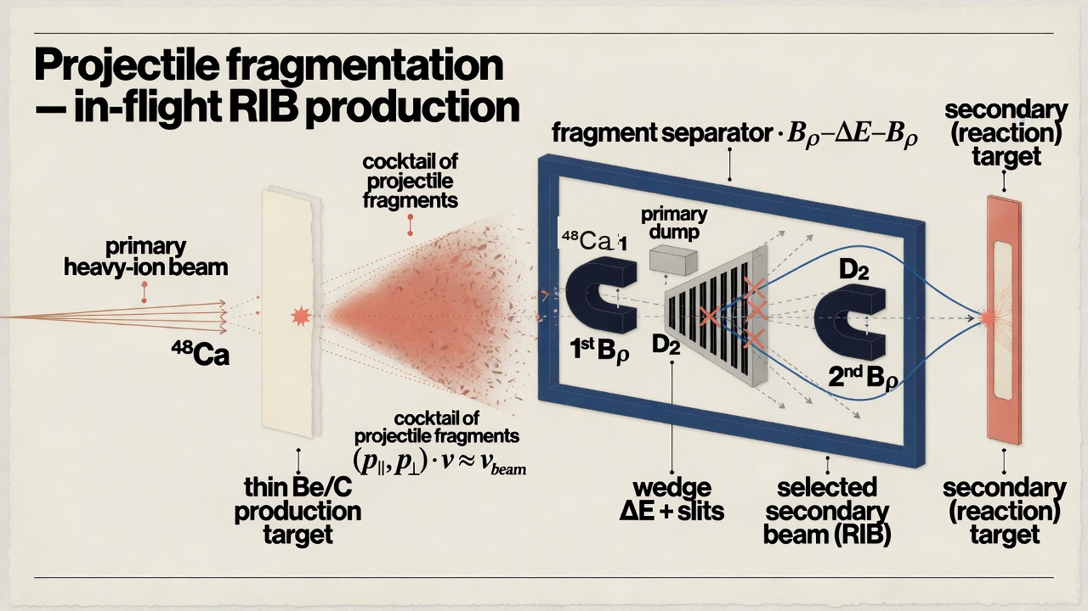
1. The secondary-beam production chain
Generated by Grok
Learning Group
2 / 10
Notes:
【中文】
把次级束生产链画成五步，就很好记。
第一步：高能稳定重离子初级束打进来。
第二步：打到低 Z 生产靶上——铍、碳一类——碎片在前向锥里产生。
第三步：出来的是各种 (A,Z) 的“鸡尾酒”，但速度几乎都和初级束一样。
第四步：分离器做 Bρ–ΔE–Bρ，把目标核从鸡尾酒里挑出来。
第五步：把这条次级束送到物理靶上做反应。
关键在于：弹核碎裂把“产生”和“在线筛选”接成同一条生产线。不是先化学分离、再慢吞吞地提取，而是束一打靶，碎片已经带着可用的运动学往前飞，分离器在飞行中完成选核。后面讲动量云和 Bρ 时，都会回到这张图上的第三、四步。
[English]
Think of the secondary-beam chain as five steps.
One: a high-energy stable heavy-ion primary beam.
Two: it hits a thin, low-Z production target — beryllium or carbon — and fragments are born in the forward cone.
Three: you get a cocktail of many (A,Z) species, all at nearly the same velocity as the primary.
Four: a separator runs Bρ–ΔE–Bρ and picks out the species you want.
Five: that secondary beam goes onto a physics target for the reaction.
The point is that projectile fragmentation stitches production and in-flight filtering into one practical line. You are not waiting on chemistry and slow extraction: once the beam hits the target, fragments already fly forward with usable kinematics, and the separator selects them in flight. When we talk about the momentum cloud and Bρ later, we are really talking about steps three and four on this chain.

Slide 5
2. What is Projectile Fragmentation?
A heavy-ion projectile collides with a target at beam energy ≫ nucleon binding energy. In a peripheral collision, nucleons are stripped from the projectile; the remnant flies on near beam velocity as a projectile fragment.
Abrasion
1
Overlapping nucleons are sheared off in the geometric overlap zone; a hot, excited prefragment of the projectile remains.
Ablation
2
The prefragment de-excites by evaporating nucleons and light clusters, leaving the final fragment species observed downstream.
Forward kinematics
3
Fragments leave at v ≈ v_beam in a narrow forward cone — high collection efficiency, simple magnetic separation, path to exotic RIB beams.
Learning Group
3 / 10
Notes:
【中文】
第二个问题：弹核碎裂究竟是什么？
定义先讲清楚：重离子弹核与靶核碰撞，束能远高于核子结合能。在外围碰撞中，弹核被剥离掉部分核子，剩余部分以接近束流速度继续前飞——这就是弹核碎片。
过程用经典的两步图像记忆：
第一，擦碎（Abrasion）。几何重叠区里的核子被“削掉”，留下一个热的、激发的弹核预碎片。
第二，烧蚀（Ablation）。预碎片通过蒸发核子和轻集团退激，下游观测到的才是最终碎片核素。
第三，前向运动学。碎片以 v ≈ v_beam 飞出，落在窄前向锥内——收集效率高、磁分离简单，也是通向奇异放射性束（RIB）的路径。
定义讲清机制，三条讲清为何能当生产线：过程清楚、运动学干净、便于分离与收集。
[English]
Second question: what is projectile fragmentation?
Start with the definition. A heavy-ion projectile collides with a target at beam energy much larger than the nucleon binding energy. In a peripheral collision, nucleons are stripped from the projectile; the remnant continues near beam velocity as a projectile fragment.
Lock in the classic two-step picture:
One — abrasion. Nucleons in the geometric overlap zone are sheared off, leaving a hot, excited prefragment of the projectile.
Two — ablation. The prefragment de-excites by evaporating nucleons and light clusters; the species observed downstream is the final fragment.
Three — forward kinematics. Fragments leave at v ≈ v_beam in a narrow forward cone — high collection efficiency, simple magnetic separation, and the path to exotic RIB beams.
Definition first (the mechanism), then why it works as a production line: clear process, clean kinematics, easy to separate and collect.

Slide 6
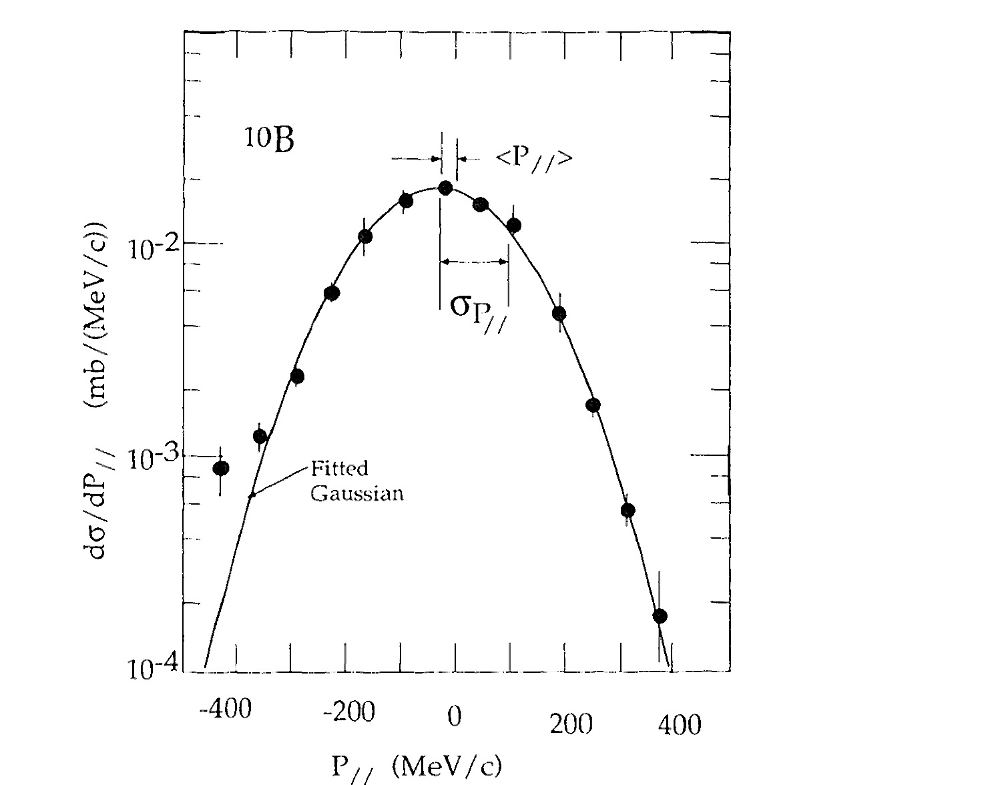




2. Momentum distribution of fragments
Gaussian shape
Fits all isotopes — independent of beam, energy, or target.
$$σ_{∥} ≈ σ_{t}$$
Parallel and transverse widths nearly equal (isotropic in the moving frame).
$$⟨P_{∥}⟩ shift$$
Central momentum −10 to −130 MeV/c (fragment slightly slower than projectile).
Same velocity
Total $P ≫ ⟨P_{∥}⟩ ⇒ v_{F} ≈ v_{beam}$ — key for separators.
Fig. 1 · ${}_{4}^{10}{Be} from {}_{6}^{12}C @ 2.1A GeV (projectile rest frame)$
Learning Group
4 / 10
Notes:
【中文】
有了定义，下一步看碎片的动量分布——这直接决定分离器能吃下多少。
左边图是经典例子：2.1A GeV 的碳-12 碎裂产生铍-10，画在弹核静止系里的动量分布。请注意几个普适特征。
形状是高斯的，而且对各种同位素都成立，几乎不依赖束流、能量和靶。平行方向和横向的宽度差不多——在运动系里接近各向同性。分布中心不在零，而是略向负动量偏，大约 −10 到 −130 MeV/c，意思是碎片比弹核稍慢一点。
但关键在最后一点：碎片的总动量远大于这个中心偏移。所以在实验室系里，碎片速度仍然几乎等于束流速度。分离器吃的就是这个“同速、前向、高斯云”的图像。下一页我们用 Goldhaber 公式把云的宽度定量下来。
[English]
With the definition, look at the fragment momentum distribution — that is what decides how much the separator can capture.
The figure on the left is the classic case: beryllium-10 from carbon-12 at 2.1A GeV, plotted in the projectile rest frame. A few features are essentially universal.
The shape is Gaussian, and it fits isotope after isotope — almost independent of beam, energy, and target. Parallel and transverse widths are nearly equal: roughly isotropic in the moving frame. The center is not at zero; it sits slightly negative, about −10 to −130 MeV/c, so the fragment is a bit slower than the projectile.
The last point is the one that matters for separators: the fragment’s total momentum is still much larger than that central shift. In the lab frame, v_F stays ≈ v_beam. What the separator sees is this same-velocity, forward, Gaussian cloud. Next we quantify the cloud width with the Goldhaber formula.

Slide 7
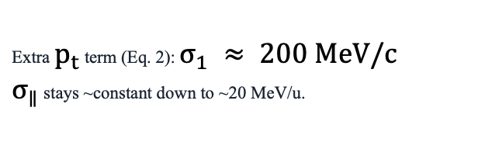
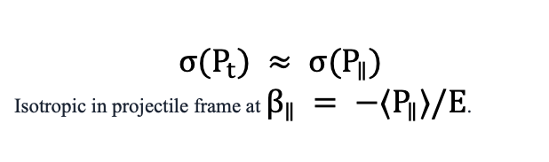

2. Goldhaber width — how broad is the cloud?
$σ(P_{∥})$ is essentially independent of target mass and beam energy; it depends on projectile and fragment mass numbers.
$$σ(P_{∥}) = σ_{0} \sqrt{\frac{A_{F}(A_{p} − A_{F})}{A_{p} − 1}}$$
$$σ_{0} ≈ 90 MeV/c · maximum when A_{F} = A_{p}/2$$
High energy (≥ 200 MeV/u)
Low energy (< 200 MeV/u)
$$σ(P_{t}) ≈ σ(P_{∥})$$
Isotropic in projectile frame at $β_{∥} = −⟨P_{∥}⟩/E$.
Extra $p_{t}$ term (Eq. 2): $σ_{1} ≈ 200 MeV/c$
$σ_{∥}$ stays ~constant down to ~20 MeV/u.
Learning Group
5 / 10
Notes:
【中文】
云有多宽？Goldhaber 给了一个非常干净的答案。
平行动量宽度写成：σ(P∥) = σ₀ √[A_F (A_p − A_F)/(A_p − 1)]，其中 σ₀ 大约 90 MeV/c。注意：这个宽度几乎不依赖靶质量和束能，只依赖弹核与碎片的质量数。当 A_F 等于 A_p 的一半时，宽度最大——掉核子最多的时候，涨落也最大。
高能区，大约 200 MeV/u 以上，横向宽度和平行宽度差不多，弹核系里近似各向同性。低能区要小心：横向会多出一项 σ₁，大约 200 MeV/c；而平行宽度大致可以维持到约 20 MeV/u。
工程上怎么用？想要窄云，就选 A_p 尽量接近目标 A_F，并且 Z_p、N_p 都不小于碎片的 Z、N。换句话说：别用差太远的弹核去“硬砍”出目标核，否则 Goldhaber 宽度会把产额摊到更大的相空间里，固定接受度的探测器只能吃到更小的份额。
[English]
How broad is the cloud? Goldhaber gives a clean answer.
The parallel momentum width is σ(P∥) = σ₀ √[A_F (A_p − A_F)/(A_p − 1)], with σ₀ around 90 MeV/c. Notice: the width is essentially independent of target mass and beam energy; it depends on the projectile and fragment mass numbers. It is widest when A_F is half of A_p — when you remove the most nucleons, the fluctuation is largest.
At high energy, roughly ≥200 MeV/u, transverse and parallel widths match: nearly isotropic in the projectile frame. At lower energy, watch the extra transverse term σ₁ ≈ 200 MeV/c; the parallel width stays roughly constant down to about 20 MeV/u.
Consequently for a narrow cloud, choose A_p close to the target A_F, with Z_p and N_p at least as large as those of the fragment. It is impractical to produce the desired nucleus from a far-away projectile — Goldhaber broadening spreads fixed yield over more phase space, and a fixed-acceptance detector captures a smaller fraction.

Slide 8
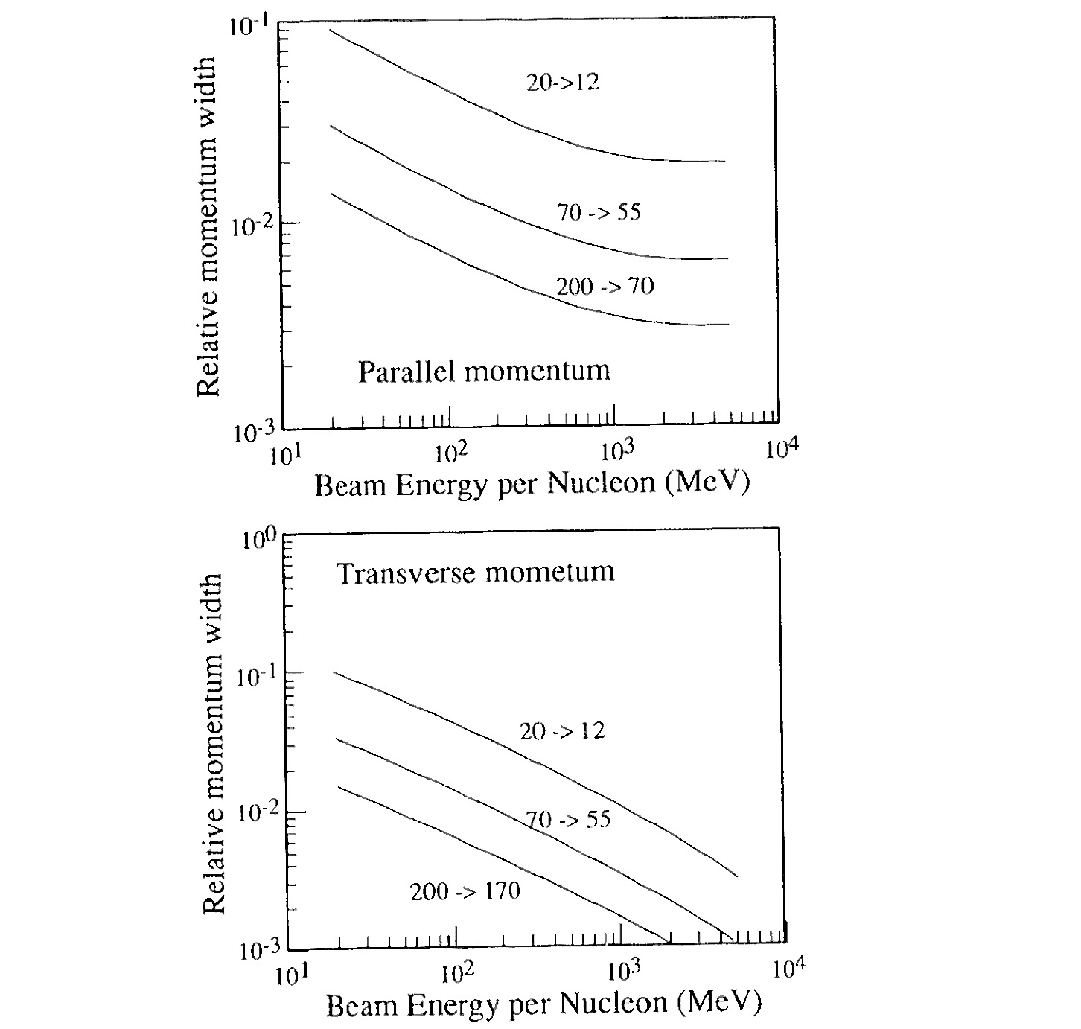


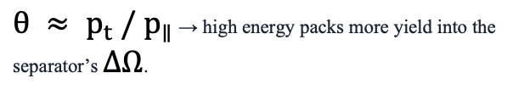
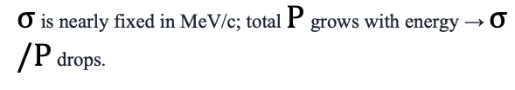
2. Why high energy helps collection
Relative width shrinks
$σ$ is nearly fixed in MeV/c; total $P$ grows with energy → $σ/P$ drops.
Narrower lab angles
$θ ≈ p_{t} / p_{∥}$ → high energy packs more yield into the separator’s $ΔΩ$.
Higher collection ε
$I_{sec} = R_{prod} × ε_{coll} × ⋯$ Fixed machine acceptance captures a larger fraction.
Design tip
Choose $A_{p} ≈ A_{F}$ (and $Z_{p}, N_{p} ≥ Z_{F}, N_{F}$) to minimize broadening.
Fig. 2 · Relative momentum width vs beam energy
Learning Group
6 / 10
Notes:
【中文】
为什么高能反而有利于收集？这张图把逻辑说透了。
图2画的是相对动量宽度 σ/P 随束能的变化。绝对宽度 σ 以 MeV/c 计大致固定——Goldhaber 已经告诉我们这一点——但总动量 P 随能量升高。所以相对宽度 σ/P 往下掉。
实验室角 θ 大约是 p_t 除以 p∥。相对宽度变小，角分布就收窄。分离器的立体角接受度 ΔΩ 和动量接受度 Δp 是机器给定的：云越集中，落在窗口里的份额 ε 就越高。
交付的次级强度是 I_sec = R_prod × ε_coll × …。这里有个容易误会的点：云更宽并不等于产额更高。反应产额大致固定时，宽度只是把产额摊在更大的相空间里；机器只认固定窗口。所以高能的好处，是把同一团产额“压”进接受度。
设计 tip 再强调一次：选 A_p 接近 A_F，并保证质子数、中子数足够，把展宽压到最小。
[English]
Why does high energy help collection? Let’s walk through the logic.
Figure 2 shows the relative momentum width σ/P versus beam energy. The absolute width σ in MeV/c is roughly fixed — Goldhaber already told us that — while the total momentum P grows with energy. So the relative width σ/P falls.
Lab angles scale like θ ≈ p_t / p∥. As the relative width shrinks, the angular distribution tightens. Separator solid-angle and momentum acceptances ΔΩ and Δp are fixed by the machine: the more concentrated the cloud, the larger the capturable fraction ε.
Delivered secondary intensity is I_sec = R_prod × ε_coll × …. A common confusion: a wider cloud does not mean more production. For roughly fixed reaction yield, width only redistributes that yield in phase space; the machine still keeps a fixed window. High energy helps by packing the same yield into the acceptance.
One more time on the design tip: choose A_p near A_F, with enough protons and neutrons, to keep the broadening small.

Slide 9
3. Why we need Projectile Fragmentation
The production challenge
What PF delivers
Exotic nuclei are required for structure, reactions, and astrophysics — but most are short-lived.
• Stable beams stay near the valley of stability
• Slow methods lose the shortest half-lives
• Chemistry-limited extraction misses many species
A fast, universal in-flight route is essential.
Projectile fragmentation is that route.
• Production on nuclear timescales (~ns)
• One primary beam → broad (A,Z) cocktail
• Forward-focused, nearly equal velocities
• Magnetic separation & secondary reactions
PF makes energetic RIB practical — not only decay spectroscopy.
Learning Group
7 / 10
Notes:
【中文】
第三个问题：我们为什么需要弹核碎裂？
左边是生产端的挑战。结构、反应、天体物理都需要奇异核，但它们大多短寿命。稳定束加稳定靶，测量基本锁在稳定线附近的窄谷里；慢方法会丢掉最短的半衰期；依赖化学提取的路线，很多核素根本过不来。所以需要一条快的、普适的在线路径。
右边是 PF 给出的答案。产生发生在核时标上，大约纳秒量级。一条初级束可以同时给出很宽的 (A,Z) 鸡尾酒。碎片前向聚焦、速度几乎相同，于是磁分离成立，次级束还能接着做反应——不只是停下来做衰变谱学。
一句话：PF 把 β 不稳定核放进入射道，让高能放射性束反应变得现实。中子晕、厚中子皮、同位旋依赖、热 CNO 和大爆炸核合成路径、新同位素以及质量与矩的测量，都建立在这个基础上。
[English]
Third question: why do we need projectile fragmentation?
On the left, the production challenge. Structure, reactions, and astrophysics all want exotic nuclei — and most of them are short-lived. Stable beam plus stable target keeps us in the narrow valley of stability. Slow methods lose the shortest half-lives. Chemistry-limited extraction misses many species. We need a fast, universal in-flight route.
On the right, what PF delivers. Production happens on nuclear timescales — about a nanosecond. One primary beam yields a broad (A,Z) cocktail. Fragments are forward-focused with nearly equal velocities, so magnetic separation works and the secondary beam can still do reactions — not only stop for decay spectroscopy.
In one line: PF puts a β-unstable nucleus in the entrance channel and makes energetic radioactive-beam reactions practical. Neutron halos, thick neutron skins, isospin dependence, hot CNO and Big Bang paths, new isotopes, masses and moments — all rest on that.

Slide 10
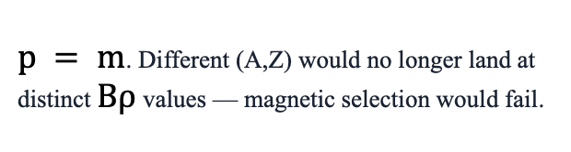
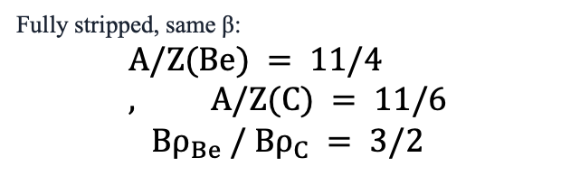

3. Same velocity → magnetic separation works
Because fragment velocities are nearly equal, magnetic rigidity maps cleanly onto $A/q$.
$$Bρ ∼ p/q with p ≈ A · m_{u} · v$$
$$same β ⇒ Bρ ∼ A/q (fully stripped: Bρ ∼ A/Z)$$
Example: ${}_{4}^{11}{Be} vs {}_{6}^{11}C$
If velocities differed
Fully stripped, same β:
$$A/Z(Be) = 11/4 , A/Z(C) = 11/6$$
$${Bρ}_{Be} / {Bρ}_{C} = 3/2$$
$p = m$. Different (A,Z) would no longer land at distinct $Bρ$ values — magnetic selection would fail.
Learning Group
8 / 10
Notes:
【中文】
同速度为什么让磁分离成立？把公式摊开就清楚了。
磁刚度 Bρ 正比于 p/q，而动量 p 大约是 A m_u v。如果所有碎片的 β 几乎一样，Bρ 就正比于 A/q；全剥离时进一步变成正比于 A/Z。也就是说：速度相同，磁刚度直接映射到荷质比。
举个具体例子：铍-11 和碳-11，全剥离、同 β。A/Z 分别是 11/4 和 11/6，所以 (Bρ)_Be 与 (Bρ)_C 之比是 3/2。它们会落在清晰分开的 Bρ 上，第一级磁选就能分开。
反过来想：如果速度乱飞，不同 (A,Z) 会在 Bρ 上搅成一团，磁选就失效了。所以前面反复强调的“v ≈ v_beam”，不是细节，而是整个在线分离架构的前提。下一页我们把这个前提接到靶和分离器的设计要求上。
[English]
Why does shared velocity make magnetic separation work? Open the formulas and it is immediate.
Magnetic rigidity Bρ is proportional to p/q, and momentum p is roughly A m_u v. If every fragment has nearly the same β, Bρ scales with A/q; fully stripped, that becomes A/Z. Same speed means rigidity maps cleanly onto charge-to-mass.
Concrete example: beryllium-11 versus carbon-11, fully stripped, same β. A/Z is 11/4 versus 11/6, so the Bρ ratio is 3/2. They land at clearly separated rigidities — a first magnetic stage can split them.
Now invert the argument: if velocities differed wildly, different (A,Z) would scramble in Bρ space and magnetic selection would fail. The “v ≈ v_beam” we kept stressing is not a detail; it is the premise of the whole in-flight architecture. Next we connect that premise to target and separator design.

Slide 11

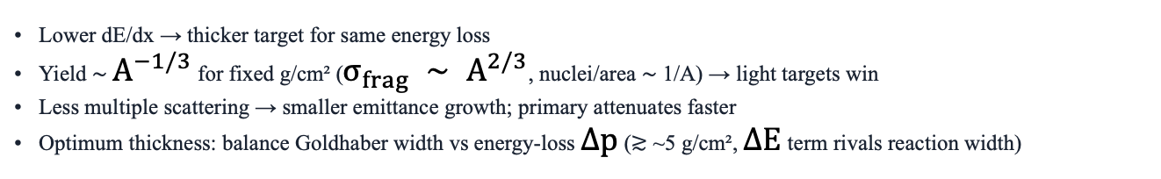

4. Practical use — separation principles & target
Three design requirements for efficient secondary-beam delivery
1
2
3
Narrow production
Large acceptance
Achromatic delivery
Target & reaction chosen so $σ_{p} and σ_{θ}$ stay small
Separator $Δp and ΔΩ$ as large as practical
Momentum spread != position smear at physics focus
Target material: prefer low-Z (e.g. Be)
Lower dE/dx → thicker target for same energy loss
Yield ∼ $A^{−1/3}$ for fixed g/cm² ($σ_{frag} ∼ A^{2/3}$, nuclei/area ∼ 1/A) → light targets win
Less multiple scattering → smaller emittance growth; primary attenuates faster
Optimum thickness: balance Goldhaber width vs energy-loss $Δp$ (≳ ~5 g/cm², $ΔE$ term rivals reaction width)
Learning Group
9 / 10
Notes:
【中文】
第四部分：实际怎么用。谷畑在 B 节给出高效次级束的三条设计要求，我建议大家对着板子记。
第一，窄产生：靶和反应机制要把动量展宽、角展宽压小。PF 本身、足够高的能量、以及合适的 A_p，都往这个方向帮你。
第二，大接受度：分离器的 Δp、ΔΩ 尽量做大——机器窗口越大，同一团云里能吃下的越多。
第三，消色差交付：动量有展宽没关系，但不能在物理焦点上变成位置弥散。否则次级束焦斑糊掉，反应实验吃亏。
下面一块讲靶材。偏好低 Z，典型是铍。原因有几条：dE/dx 小，同样能损下可以做更厚的靶；固定克重面密度时产额大致按 A 的负三分之一次方走，轻靶更合算；多重散射小，发射度涨得慢；初级束也衰减得更快。厚度要在产额和能损引起的额外 Δp 之间权衡——太厚时能损展宽会赶上甚至超过反应本身的 Goldhaber 宽度，收益就没了。
[English]
Part four: practical use. Tanihata’s section B gives three design requirements for efficient secondary-beam delivery — worth keeping on the board.
One: narrow production. Choose target and reaction so momentum and angular widths stay small. PF itself, high enough energy, and a sensible A_p all push you that way.
Two: large acceptance. Make separator Δp and ΔΩ as large as practical — a bigger machine window captures more of the same cloud.
Three: achromatic delivery. Momentum spread is fine; it must not turn into position smear at the physics focus. Otherwise the secondary spot blurs and reaction experiments pay for it.
Below that, target material. Prefer low-Z — beryllium is the classic choice. Several reasons: lower dE/dx lets you run a thicker target for the same energy loss; at fixed g/cm² the yield scales roughly like A to the minus one-third, so light targets win; less multiple scattering means slower emittance growth; and the primary attenuates faster. Thickness is a trade: maximize yield without letting energy-loss Δp rival or beat the Goldhaber reaction width — past that point, thicker is not better.

Slide 12
Summary: Answers to the outline questions
1. Where does it come from?
2. What is Projectile Fragmentation?
Any reaction making radioactive nuclei can feed a secondary beam. PF became practical after high-energy heavy-ion collisions: primary HI → production target → fragment cloud → separator → physics target.
At E ≫ nucleon binding, fragments leave in a narrow forward cone at nearly beam velocity. Yields many exotic species; σ almost energy-independent; Goldhaber width sets the momentum cloud for separation.
3. Why do we need PF?
4. Practical use of fragments
Exotic nuclei are short-lived; stable beams and slow chemistry lose them. PF produces on nuclear timescales (~ns), one beam → broad (A,Z) cocktail, forward-focused equal velocities — makes energetic RIBs practical.
Same β ⇒ Bρ ∝ A/Z; degrader adds Z purity. Need narrow production, large acceptance, achromatic delivery. Prefer low-Z thick targets + high energy. Facilities: LISE, RIPS, A1900/ARIS, FRS…
Learning Group
10 / 10
Notes:
【中文】
最后用大纲四个问题收束——对照板子上的四张卡片讲即可。
一，从何而来？任何产放射性核的反应原则上都能喂次级束；真正实用，是高能重离子里发现 PF 之后。链路就是：初级重离子 → 生产靶 → 碎片云 → 分离器 → 物理靶。
二，是什么？E 远大于结合能时，碎片以前向窄锥、近束流速度飞出；奇异核产额可用；截面近乎能无关；Goldhaber 公式定动量云，也就定了分离器能吃多少。
三，为何需要？奇异核短寿命；稳定束和慢化学会丢掉它们。PF 在核时标——纳秒量级——产生宽 (A,Z) 鸡尾酒，前向、同速，高能 RIB 反应才站得住。
四，怎么用？同 β 下 Bρ 正比 A/Z，降能片补 Z 纯度；设计上要窄产生、大接受、消色差交付；靶材偏低 Z、厚度与高能配合。LISE、RIPS、A1900/ARIS、FRS 等设施，都是这套原则的工程实现。
如果今天只记住四句话：PF 让次级束实用；同速让磁选成立；宽度决定收集份额；低 Z 加高能抬强度。
[English]
Close by answering the four outline questions — walk the four cards on the slide.
One — where does it come from? Any reaction that makes radioactive nuclei can feed a secondary beam in principle; it became practical after PF was found in high-energy heavy ions. The chain is primary HI → production target → fragment cloud → separator → physics target.
Two — what is it? When E is far above binding, fragments leave in a narrow forward cone at nearly beam velocity. Exotic yields are usable; the cross section is nearly energy-independent; Goldhaber sets the momentum cloud — and thus how much the separator can capture.
Three — why do we need it? Exotics are short-lived; stable beams and slow chemistry lose them. PF produces on nuclear timescales — nanoseconds — a broad (A,Z) cocktail that is forward-focused and equal-velocity, so energetic RIB reactions actually work.
Four — practical use? Same β makes Bρ scale with A/Z; the degrader adds Z purity. Design for narrow production, large acceptance, and achromatic delivery. Prefer low-Z targets, sensible thickness, and high energy. LISE, RIPS, A1900/ARIS, FRS and the rest are this principle engineered.
If you keep only four lines: PF made secondary beams practical; same velocity makes magnetic selection work; cloud width sets the capturable fraction; low-Z plus high energy raise delivered intensity.

Slide 13
Thank you
Questions & discussion
Source: I. Tanihata — Production and Use of Radioactive Beams
(Experimental Techniques in Nuclear Physics, Ch. 10)
Learning Group · Zhiheng Hu · 11 Aug 2026
Notes:
【中文】
谢谢大家。
材料来源是 I. Tanihata，《放射性束的产生与利用》，收在 Experimental Techniques in Nuclear Physics 第 10 章。如果对某一张图、某个公式，或者你们自己束线/实验上的对应关系有问题，我们现在可以展开讨论。
[English]
Thank you.
The source is I. Tanihata, Production and Use of Radioactive Beams, Chapter 10 of Experimental Techniques in Nuclear Physics. Happy to take questions — on a figure, a formula, or how this maps onto your own beam line or experiment. Let's discuss.

